Slide 1
Branch Accounts

Slide 2
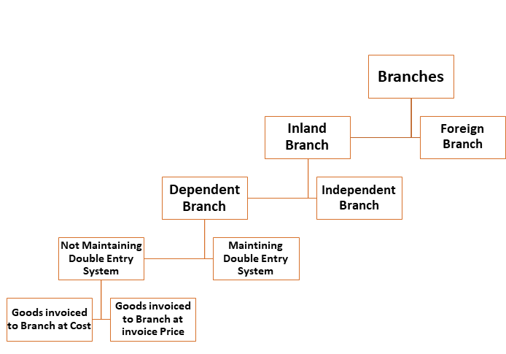
Introduction to Branch Accounts
Branch accounts are used to record the financial transactions of different branches of a business.
They help in determining the profitability and performance of each branch separately.
Understanding branch accounts is crucial for effective financial management and decision-making.
Notes:
Image source: https://indiafreenotes.com/branch-accounts-introduction-meaning-objectives/

Slide 3
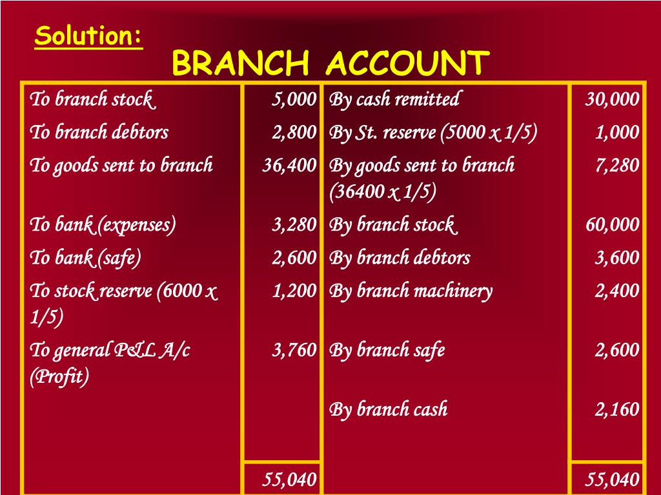
Purpose of Branch Accounts
The primary purpose of branch accounts is to provide insights into each branch's financial health.
They facilitate the evaluation of branch performance against budgets and forecasts.
Branch accounts also assist in identifying areas for improvement and strategic growth.
Notes:
Image source: https://www.slideserve.com/yukio/branch-accounting

Slide 4
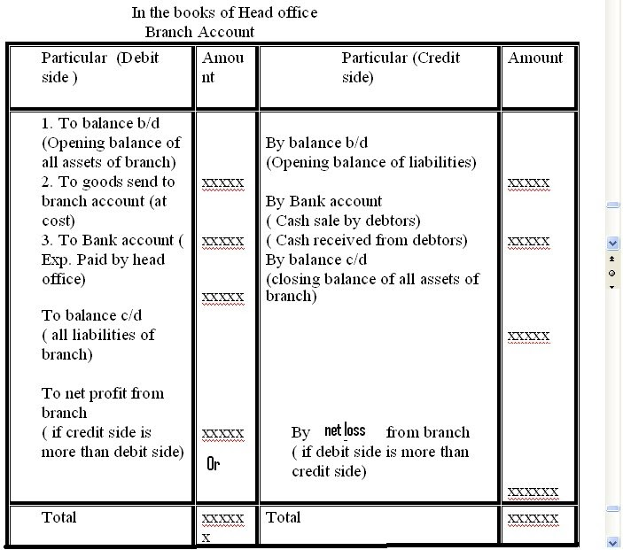
Structure of Branch Accounts
Branch accounts typically include a branch profit and loss account and a branch balance sheet.
The profit and loss account summarizes the revenues and expenses of the branch.
The balance sheet provides a snapshot of the branch’s assets, liabilities, and equity at a specific point in time.
Notes:
Image source: http://www.svtuition.org/2008/10/branch-accounting-full-tutorial.html

Slide 5
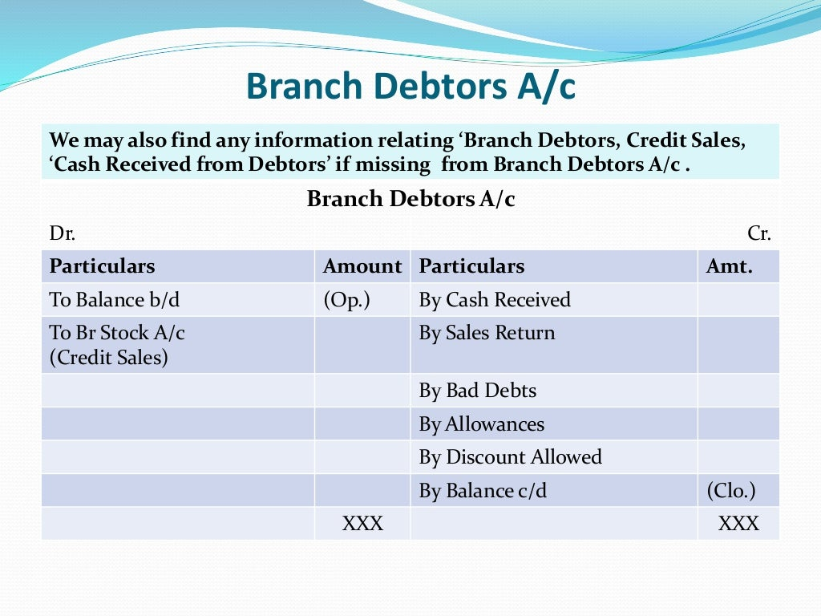
Methods of Maintaining Branch Accounts
There are two primary methods: the Debtors and Creditors Method and the Independent Branch Method.
The Debtors and Creditors Method records transactions in the main account while maintaining a separate branch account.
The Independent Branch Method treats branch accounts as standalone entities, providing complete financial records for each branch.
Notes:
Image source: https://www.slideshare.net/mcsharma1/branch-accounting-stock-and-debtors-method/7

Slide 6
Key Components of Branch Accounts
Revenue generated by the branch, including sales and other income, is a key component.
Direct and indirect expenses incurred by the branch are also recorded to assess profitability.
Assets and liabilities specific to the branch must be tracked to maintain accurate financial reporting.
Notes:
Image source: http://www.svtuition.org/2008/10/branch-accounting-full-tutorial.html

Slide 7
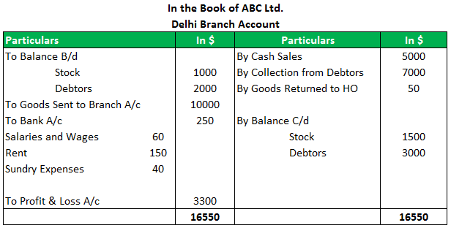
Inter-Branch Transactions
Inter-branch transactions occur when goods or services are exchanged between branches.
These transactions must be accurately recorded to ensure proper accounting and financial integrity.
It is essential to establish clear policies for pricing and recording inter-branch transactions.
Notes:
Image source: https://www.wallstreetmojo.com/branch-accounting/

Slide 8

Challenges in Branch Accounting
One major challenge is ensuring consistency in accounting practices across different branches.
Currency differences and local regulations can complicate the financial reporting process.
Another challenge is timely communication and data sharing between branches and the head office.
Notes:
Image source: https://smallbusinesshq.co/challenges-of-financial-accounting/

Slide 9
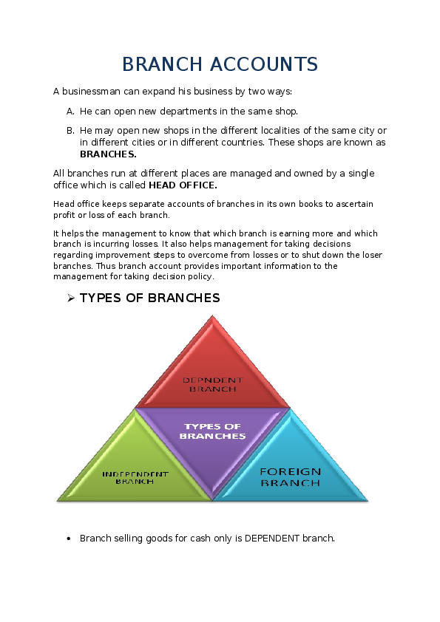
Benefits of Using Branch Accounts
Branch accounts provide detailed insights into the operations and profitability of each branch.
They enhance accountability and responsibility among branch managers for their financial performance.
Using branch accounts can lead to better resource allocation and strategic planning.
Notes:
Image source: https://www.academia.edu/4220033/BRANCH_ACCOUNTS

Slide 10

Technology and Branch Accounts
Advanced accounting software can streamline the management of branch accounts.
Automation reduces the risk of errors and enhances the efficiency of financial reporting processes.
Cloud-based systems allow real-time access to financial data across all branches, improving decision-making.
Notes:
Image source: https://www.microchannel.asia/microsoft-accounting-software/

Slide 11
Conclusion
Branch accounts are essential for effective financial management in multi-branch organizations.
They provide valuable insights that contribute to strategic planning and operational efficiency.
Understanding and implementing robust branch accounting practices can drive business success.
Feel free to adjust or expand on any points as needed!
Notes:
Image source: https://www.academia.edu/4220033/BRANCH_ACCOUNTS

